Slide 1

Control bus

Slide 2
EE-2003
Computer Organization & Assembly Language
INSTRUCTOR
Engr. Aamir Ali
Lecturer, Department of Electrical Engineering
Office: 1st Floor EE Faculty
FAST NUCES (Karachi)
aamir.ali@nu.edu.pk

Slide 3
Chapter No: 05
Procedure

Slide 4
Overview
Stack Operations
Defining and Using Procedures
Stack frames, parameters and local variables
Recursion
Related directives

Slide 5
Stacks

Slide 6
Stacks
LIFO (Last-In, First-Out) data structure
  push/ pop operations
You probably have had experiences on implementing it in high-level languages
Here, we concentrate on runtime stack, directly supported by hardware in the CPU
  It is essential for calling and returning from procedures
  The runtime stack stores information about the active subroutines of a computer program

Slide 7
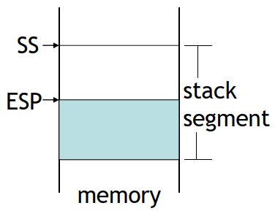
Runtime Stack
Managed by the CPU, using two registers
  SS (stack segment)
  ESP (stack pointer) : point to the top of the stack usually modified by CALL, RET, PUSH and POP
The runtime stack is a memory array managed directly by the CPU, using the ESP register, known as the stack pointer register.
SP in Real-address mode

Slide 8
PUSH and POP Instruction
PUSH syntax:
PUSH reg16/mem16
PUSH reg32/mem32
PUSH imm32
POP syntax:
POP reg16/mem16
POP reg32/mem32

Slide 9
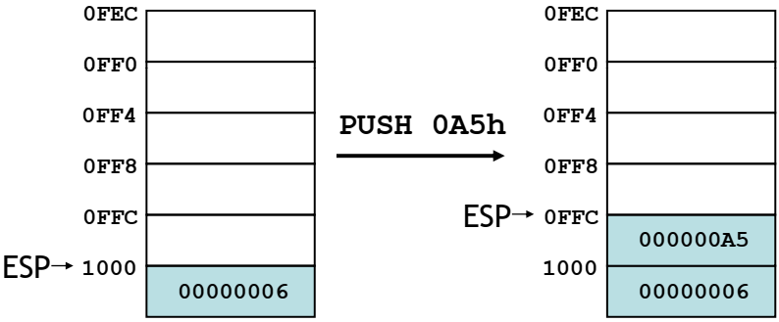
PUSH Operation
A push operation decrements the stack pointer by 2 or 4 (depending on operands) and copies a value into the location pointed to by the stack pointer

Slide 10
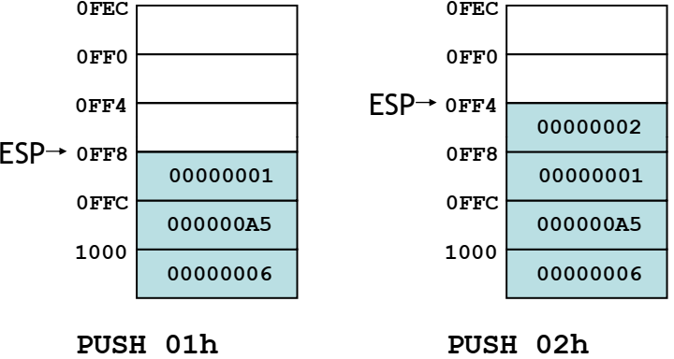
PUSH Operation
The same stack after pushing two more integers:

Slide 11
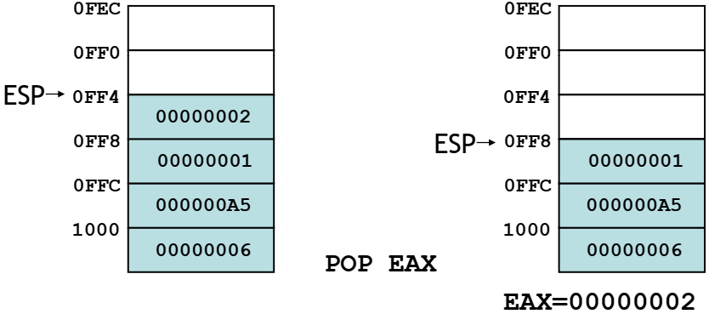
POP Operation
Copies value at stack[ESP] into a register or variable.
Adds n to ESP, where n is either 2 or 4 depending on , depending on the attribute of the operand receiving the data

Slide 12
Applications of Stacks
Temporary save area for registers
To save return address for CALL
To pass arguments
Local variables
Applications which have LIFO nature such as , such as reversing a string

Slide 13
Example
Save and restore registers when they contain important values
  The PUSH and POP instructions are in the opposite order
push esi ; push registers
push ecx
push ebx
mov esi, OFFSET dwordVal ; starting OFFSET
mov ecx, LENGTHOF dwordVal ; number of units
mov ebx, TYPE dwordVal ; size of a doubleword
call DumpMem ; display memory
pop ebx ; opposite order
pop ecx
pop esi

Slide 14
Example
When creating a nested loop, push the outer loop counter before entering the inner
mov ecx,100 ; set outer loop count
L1: ; begin the outer loop
push ecx ; save outer loop count
mov ecx,20 ; set inner loop count
L2: ; begin the inner loop
……………………..
loop L2 ; repeat the inner loop
pop ecx ; restore outer loop count
loop L1 ; repeat the outer loop

Slide 15
Example
Reversing a string (Saving a String to STACK)
.data
aName BYTE "Abraham Lincoln",0
nameSize = ($ - aName) – 1
.code
main PROC
; Push the name on the stack
mov ecx, nameSize
mov esi,0
L1:
movzx eax, aName[esi] ; get character
push eax ; push on stack
inc esi
Loop L1

Slide 16
Example
Reversing a string (Storing a String from STACK)
; Pop the name from the stack, in reverse,
; and store in the aName array.
mov ecx, nameSize
mov esi,0
L2:
pop eax ; get character
mov aName[esi] , al ; store in string
inc esi
Loop L2
exit
main ENDP
END main

Slide 17
STACK Related Instructions
PUSHFD and POPFD
  push and pop the EFLAGS register
  LAHF, SAHF are other ways to save flags
PUSHAD pushes the 32-bit general-purpose registers on the stack in the following order
  EAX, ECX, EDX, EBX, ESP, EBP, ESI, EDI
POPAD pops the same registers off the stack in reverse order
PUSHA and POPA do the same for 16-bit registers

Slide 18
Example
Recommended to not use this if your procedure uses registers for return value
MySub PROC
pushad
...
; modify some register
...
popad
ret
MySub ENDP

Slide 19
Defining & Using Procedures

Slide 20
Creating PROCEDURES
Large problems can be divided into smaller tasks to make them more manageable
A procedure is the ASM equivalent of a Java or C++ function
Following is an assembly language procedure named sample
sample PROC
...
...
ret
sample ENDP
A named block of statements that ends with a return

Slide 21
Creating PROCEDURES
Suggested documentation for each procedure:
A description of all tasks accomplished by the procedure
Receives: A list of input parameters; state their usage and requirements
Returns: A description of values returned by the procedure
Requires: Optional list of requirements called preconditions that must be satisfied before the procedure is called
  For example, a procedure of drawing lines could assume that display adapter is already in graphics mode

Slide 22
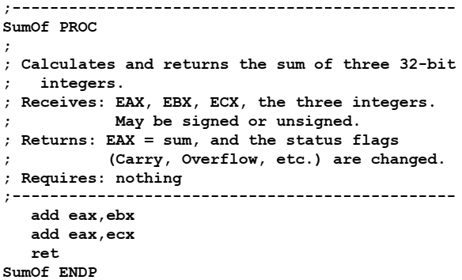
Example

Slide 23
CALL and RET Instructions
The CALL instruction calls a procedure
  pushes offset of next instruction on the stack
  copies the address of the called procedure into EIP
The RET instruction returns from a procedure
  pops top of stack into EIP

Slide 24
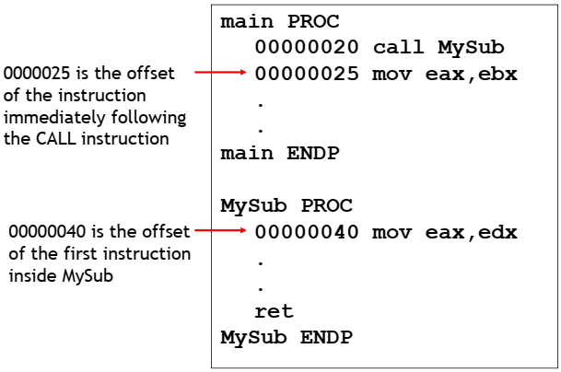
Example

Slide 25
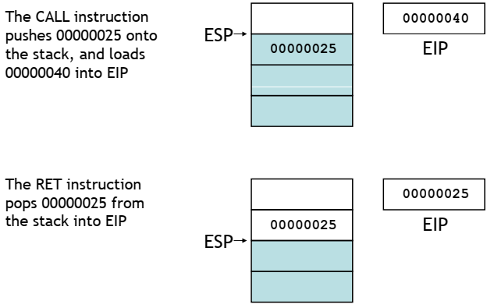
Example

Slide 26
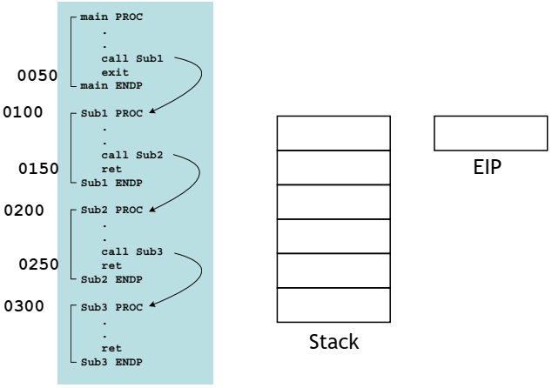
Nested Procedure Calls

Slide 27
Local and Global labels
A local label is visible only to statements inside the same procedure
A global label is visible everywhere
main PROC
jmp L2 ; error!
L1:: ; global label
exit
main ENDP
sub2 PROC
L2: ; local label
jmp L1 ; ok
ret
sub2 ENDP

Slide 28
Procedure parameters
A good procedure might be usable in many different programs
Parameters help to make procedures flexible because parameter values can change at runtime
General registers can be used to pass parameters

Slide 29
Procedure parameters
The ArraySum procedure calculates the sum of an array named myArray, it makes two references to specific variable names:
ArraySum PROC
mov esi,0 ; array index
mov eax,0 ; set the sum to zero
L1:
add eax,myArray[esi] ; add each integer to sum
add esi,4 ; point to next integer
loop L1 ; repeat f i or array size
mov theSum,eax ; store the sum
ret
ArraySum ENDP

Slide 30
Procedure parameters
This version returns the sum of any doubleword array whose address is in ESI, The sum is returned in EAX:
ArraySum PROC
; Recevies: ESI points to an array of doublewords,
; ECX = number of array elements.
; Returns: EAX = sum
;------------------------------------------------
push esi
push ecx
mov eax , 0 ; set the sum to zero
L1: add eax,[esi] ; add each integer to sum
add esi,4 ; point to next integer
loop L1 ; repeat for arra si e y size
pop ecx
pop esi
ret
ArraySum ENDP

Slide 31
Procedure parameters
Calling ArraySum
.data
array DWORD 10000h 20000h 30000h 40000h , 20000h, 30000h, 40000h
theSum DWORD ?
.code
main PROC
mov esi OFFSET array, OFFSET array
mov ecx, LENGTHOF array
call ArraySum
mov theSum, eax

Slide 32
RET Instruction
Return from subroutine
Pops stack into the instruction pointer (EIP or IP), control transfers to the target address
Syntax:
  RET
  RET n
Optional operand n causes n bytes to be added to the stack pointer after EIP (or IP) is assigned a value

Slide 33
USES Operator
Lists the registers that will be saved (to avoid side effects) (return register shouldn’t be saved)
ArraySum PROC USES esi ecx
mov eax, 0 ; set the sum to zero
...
MASM generates the following code
ArraySum PROC
push esi
push ecx
..
pop ecx
pop esi
ret
ArraySum ENDP

Slide 34
Chapter No: 06
Conditional Processing

Slide 35
Bit-wise Operations
Notes:
Bit Masking

Slide 36
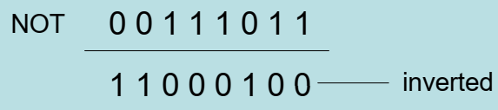
NOT Instruction
Performs a bitwise Boolean NOT operation on a single destination operand
Syntax: (no flag affected)
NOT destination
Example:
mov al 11110000b
NOT al

Slide 37
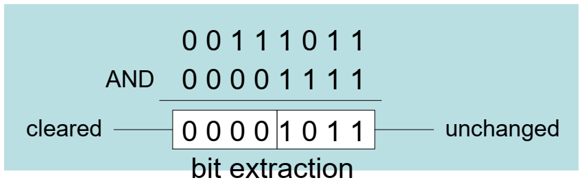
AND Instruction
Performs a bitwise Boolean AND operation between each pair of matching bits in two operands
Syntax: (O=0,C=0,SZP)
AND destination, source
Example:
mov al, 00111011b
and al, 00001111b

Slide 38
AND Instruction
Performs a bitwise Boolean AND operation between each pair of matching bits in two operands
Syntax: (O=0,C=0,SZP)
AND destination, source
Example:
mov al, 00111011b
and al, 00001111b

Slide 39
OR Instruction
Performs a bitwise Boolean OR operation between each pair of matching bits in two operands
Syntax: (O=0,C=0,SZP)
OR destination, source
Example:
mov al, 00111011b
or al, 00001111b

Slide 40
XOR Instruction
Performs a bitwise Boolean XOR operation between each pair of matching bits in two operands
Syntax: (O=0,C=0,SZP)
XOR destination, source
Example:
mov al, 00111011b
xor al, 00001111b
XOR is a useful way to invert the bits in an operand and data encryption

Slide 41
Applications
Convert the character in AL to upper case
Solution: Use the AND instruction to clear bit 5
mov al , 'a’ ; AL = 01100001b
and al , 11011111b ; AL = 01000001b
Convert a binary decimal byte into its equivalent ASCII decimal digit
Solution: Use the OR instruction to set bits 4 and 5
mov al , 6 ; AL = 00000110b
or al , 00110000b ; AL = 00110110b
Jump to a label if an integer is even
Solution: AND the lowest bit with a 1, If the result is Zero, the number was even
mov ax , wordVal
and ax , 1 ; low bit set?
jz EvenValue ; jump if Zero flag

Slide 42
Applications
Jump to a label if the value in AL is not zero
Solution: OR the byte with itself, then use the JNZ (jump if not zero) instruction
or al , al
jnz IsNotZero ; jump if not zero

Slide 43
Non-Destructive Instructions
Notes:
Bit Masking

Slide 44
TEST Instruction
Performs a nondestructive AND operation between each pair of matching bits in two operands
No operands are modified, but the flags are affected
Example: jump to a label if either bit 0 or bit 1 in AL is set
test al, 00000011b
jnz ValueFound
Example: jump to a label if neither bit 0 nor bit 1 in AL is set
test al, 00000011b
jz ValueNotFound

Slide 45
CMP Instruction
Compares the destination operand to the source operand
  Nondestructive subtraction of source from destination (destination operand is not changed)
Syntax:
CMP destination, source
Example: destination == source
mov al , 5
cmp al , 5 ; Zero flag set
Example: destination < source
mov al , 4
cmp al , 5 ; Carry flag set
Example: destination > source
mov al , 6
cmp al , 5 ; ZF = 0, CF = 0
The comparisons shown so far were unsigned

Slide 46
CMP Instruction
The comparisons shown here are performed with signed integers
Example: destination > source
mov al , 5
cmp al , -2 ; Sign flag == Overflow flag
Example: destination < source
mov al , -1
cmp al , 5 ; Sign flag != Overflow flag

Slide 47
Conditions and Output
Unsigned | ZF | CF
destination < source | 0 | 1
destination > source | 0 | 0
destination = source | 1 | 0
Signed | FLAGS
destination < source | SF != OF
destination > source | SF == OF
destination = source | ZF = 1

Slide 48
Setting and Clearing Individual Flags
and al , 0 ; set Zero
or al , 1 ; clear Zero
or al , 80h ; set Sign
and al , 7Fh ; clear Sign
stc ; set Carry
clc ; clear Carry
mov al , 7Fh
inc al ; set Overflow
or eax , 0 ; clear Overflow

Slide 49
Conditional jumps

Slide 50
Conditional Structures
There are no high-level logic structures such as if-then-else, in the IA-32 instruction set
  But, you can use combinations of comparisons and jumps to implement any logic structure
First, an operation such as CMP, AND or SUB is executed to modified the CPU flags
Second, a conditional jump instruction tests the flags and changes the execution flow accordingly
Example:
CMP AL, 0
JZ L1
...
...
L1:

Slide 51
Jcond Instructions
A conditional jump instruction branches to a label when specific register or flag conditions are met
Jcond Destination
Four groups: (some are the same)
  based on specific flag values
  based on equality between operands
  based on comparisons of unsigned operands
  based on comparisons of signed operands

Slide 52
Jumps Based on Specific Flags
Flag | Instruction | Description | Flag Status
ZERO | JZ | Jump if zero | ZF = 1
 | JNZ | Jump if not zero | ZF = 0
CARRY | JC | Jump if carry | CF = 1
 | JNC | Jump if not carry | CF = 0
Over-Flow | JO | Jump if overflow | OF = 1
 | JNO | Jump if not overflow | OF = 0
SIGN | JS | Jump if sign | SF = 1
 | JNS | Jump if not sign | SF = 0
PARITY | JP | Jump if parity (even) | PF = 1
 | JNP | Jump if not parity (odd) | PF = 0

Slide 53
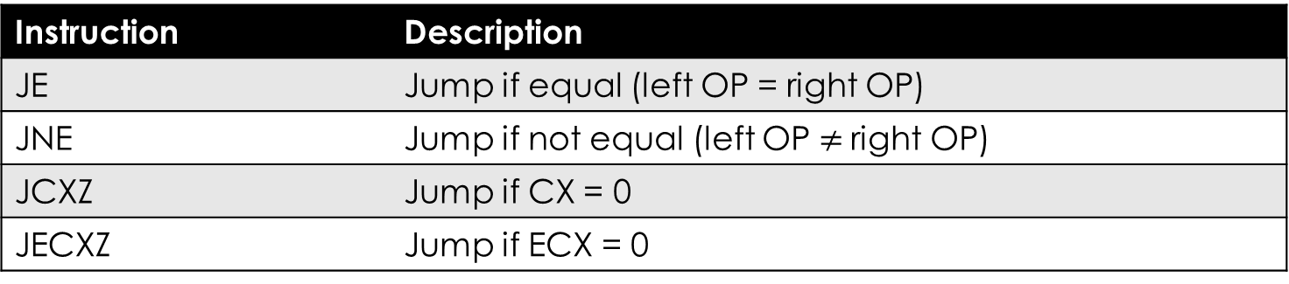
Jumps Based on Equality
Instruction | Description
JE | Jump if equal (left OP = right OP)
JNE | Jump if not equal (left OP $≠$right OP)
JCXZ | Jump if CX = 0
JECXZ | Jump if ECX = 0

Slide 54
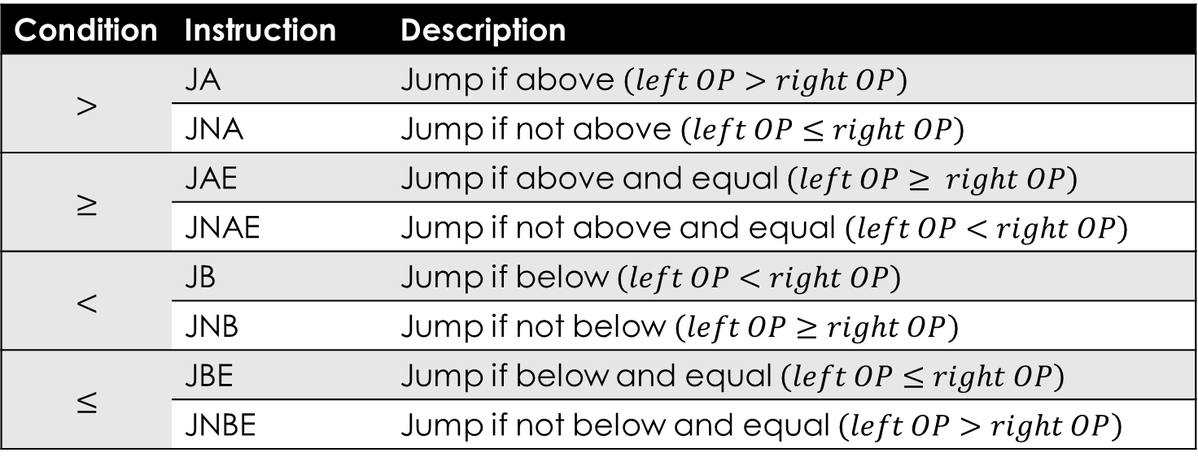
Jumps Based on Un-signed Comparison
Condition | Instruction | Description
$$>$$ | JA | Jump if above $\left(left OP>right OP\right)$
 | JNA | Jump if not above $\left(left OP≤right OP\right)$
$$≥$$ | JAE | Jump if above and equal $\left(left OP≥ right OP\right)$
 | JNAE | Jump if not above and equal $\left(left OP<right OP\right)$
$$<$$ | JB | Jump if below $\left(left OP<right OP\right)$
 | JNB | Jump if not below $\left(left OP≥right OP\right)$
$$≤$$ | JBE | Jump if below and equal $\left(left OP≤right OP\right)$
 | JNBE | Jump if not below and equal $\left(left OP>right OP\right)$

Slide 55
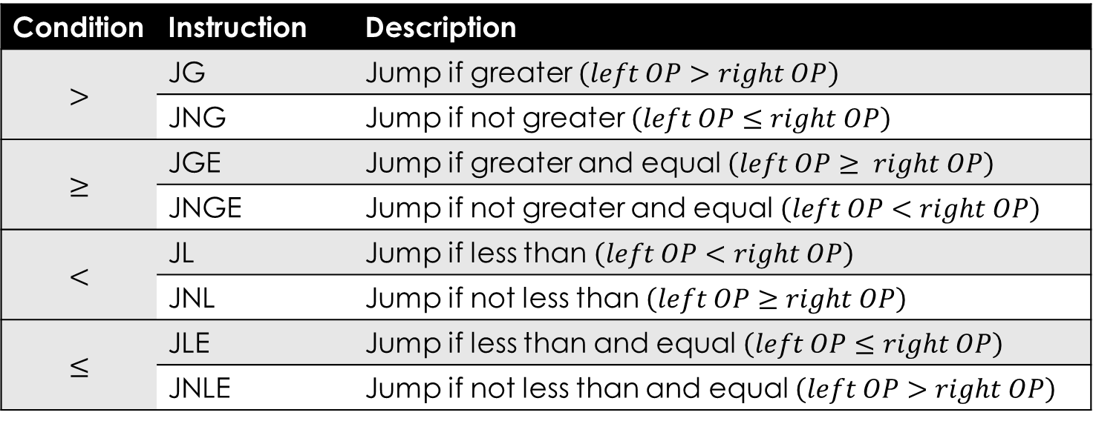
Jumps Based on Signed Comparison
Condition | Instruction | Description
$$>$$ | JG | Jump if greater $\left(left OP>right OP\right)$
 | JNG | Jump if not greater $\left(left OP≤right OP\right)$
$$≥$$ | JGE | Jump if greater and equal $\left(left OP≥ right OP\right)$
 | JNGE | Jump if not greater and equal $\left(left OP<right OP\right)$
$$<$$ | JL | Jump if less than $\left(left OP<right OP\right)$
 | JNL | Jump if not less than $\left(left OP≥right OP\right)$
$$≤$$ | JLE | Jump if less than and equal $\left(left OP≤right OP\right)$
 | JNLE | Jump if not less than and equal $\left(left OP>right OP\right)$

Slide 56
Examples
Compare unsigned AX to BX, and copy the larger of the two into a variable named Large
Solution:
  mov Large , bx
  cmp ax , bx
  jna Next
  mov Large , ax
Next:
Compare signed AX to BX, and copy the smaller of the two into a variable named small
Solution:
  mov small , ax
  cmp bx , ax
  jnl Next
  mov small , bx
Next:

Slide 57
Examples
Find the first even number in an array of unsigned Integers
Solution:
.date
intArray DWORD 7, 9, 3, 4, 6, 1
.code
...
mov ebx, OFFSET intArray
mov ecx, LENGTHOF intArray
L1: test DWORD PTR [ebx], 1
jz found
add ebx, 4
loop L1
...
Found:

Slide 58
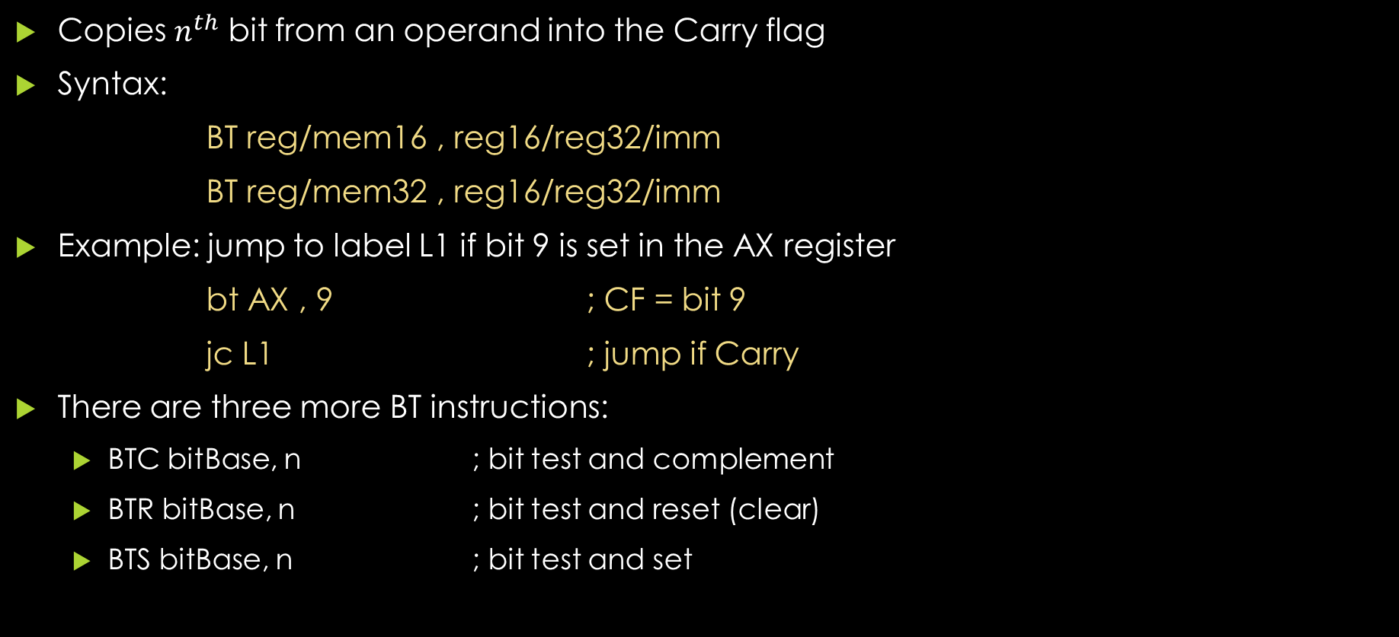
BT (Bit Test) Instruction
Copies $n^{th}$ bit from an operand into the Carry flag
Syntax:
BT reg/mem16 , reg16/reg32/imm
BT reg/mem32 , reg16/reg32/imm
Example: jump to label L1 if bit 9 is set in the AX register
bt AX , 9 ; CF = bit 9
jc L1 ; jump if Carry
There are three more BT instructions:
  BTC bitBase, n ; bit test and complement
  BTR bitBase, n ; bit test and reset (clear)
  BTS bitBase, n ; bit test and set

Slide 59
Conditional Structures

Slide 60
If Statements
If then else
JNE esle
JMP endif
else:
endif:
Condition
Then
Else
Condition
Then
Else

Slide 61
Block-structured If Statements
Assembly language programmers can easily translate logical statements written in C++ into assembly language. For example
JNE else
JMP endif
else:
Endif:
JNE else
JMP endif
else:
Endif:
Condition
Mov EAX, op1
CMP EAX, op2
if( op1 == op2 )
X = 1;
else
X = 2;
Then
MOV X , 1
Else
MOV X , 2

Slide 62
Exercise
Implement the following pseudocode in assembly language, all values are unsigned:
if( ebx <= ecx )
{
eax = 5;
edx = 6;
}
JA endif
Endif:
CMP EBX, ECX
MOV EAX , 5
MOV EDX , 6

Slide 63
Exercise
Implement the following pseudocode in assembly language, all values are 32-bit signed integer
JG else
JMP endif
else:
Endif:
JLE if
JMP endif
if:
Endif:
Mov EAX, var1
CMP EAX, var2
Mov EAX, var1
CMP EAX, var2
if( va1 <= var2 )
var3 = 10;
else
{
var3 = 6;
var4 = 7;
}
MOV var3 , 10
MOV var3 , 6
MOV var4 , 7
MOV var3 , 6
MOV var4 , 7
MOV var3 , 10

Slide 64
Compound Expression with AND
When implementing the logical AND operator, consider that HLLs use short-circuit evaluation
In the following example, if the first expression is false, the second expression is skipped
if(al > bl && bl > cl)
X = 1;
cmp al,bl ;1st expression
ja L1
jmp next
L1:
cmp bl,cl ;2nd expression
ja L2
jmp next
L2: ; both are true
mov X,1 ; set X to 1
next:
cmp al,bl ;1st expression
jbe next
cmp bl,cl ;2nd expression
jbe next
mov X,1 ; set X to 1
next:

Slide 65
Compound Expression with OR
In the following example, if the first expression is true, the second expression is skipped
if(al > bl || bl > cl)
X = 1;
cmp al,bl ;1st expression
jbe L1
jmp L2
L1:
cmp bl,cl ;2nd expression
jbe next
L2: ; both are true
mov X,1 ; set X to 1
next:
cmp al,bl ;1st expression
ja L1
cmp bl,cl ;2nd expression
jbe next
L1:
mov X,1 ; set X to 1
next:

Slide 66
Exercise
Implement the following pseudocode in assembly language, all values are unsigned:
Endif:
if( ebx <= ecx && ecx > edx)
{
eax = 5;
edx = 6;
}
CMP EBX, ECX
JA endif
CMP ECX, EDX
JBE endif
MOV EAX , 5
MOV EDX , 6

Slide 67


